Slide 1
Impulse Entertainment
2010-2011

Slide 2
Company Description
C Corporation
Founded on November 1, 2007
Past: Teen Night Club
Current: “Go Green Campaign”

Slide 3
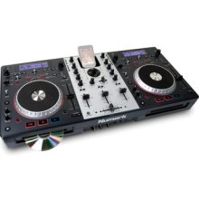
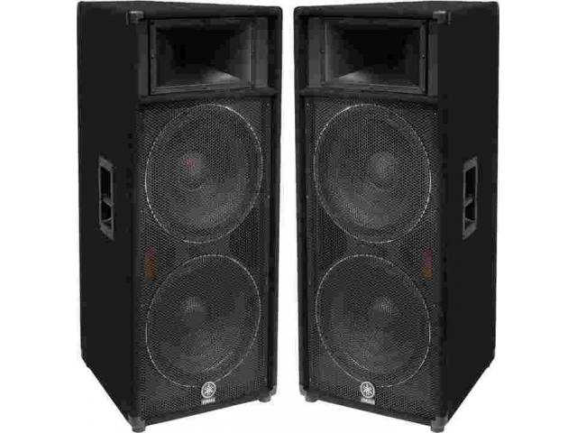
Marketing Plan - Products
Awesome DJs
(DJs are sub-contracted)
Spectacular Staging Equipment
Lighting Equipment
(Includes LED Lighting)
Cutting Edge BOSE -Sound Equipment

Slide 4
Marketing Plan - Pricing
Price Range: $500- 12,000
Bakersfield Trade Fair Special $ 500
Intermediate Package $ 1,000
Dance Package $ 2,500
Special Effects Package $ 3,500
Time to Party Package $ 4,500
Ultimate Party Package $ 6,000
Spectacular Impulse Package $12,000
Customizable Products:
Staging: $ 40 per sq. ft.
DJ: $ 75+ per hour
Sound (speakers): $ 200 per day
LED Lighting: $ 175 per day
(Varies based on wattage)

Slide 5
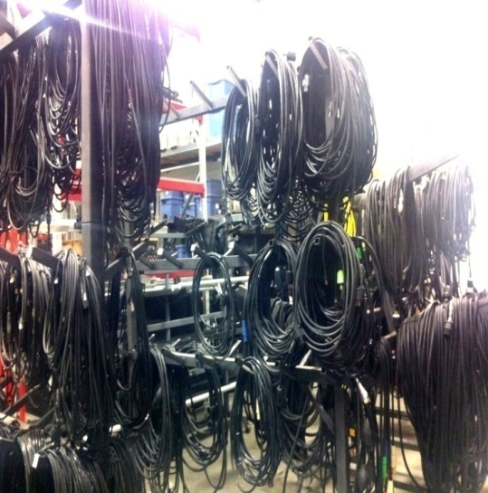
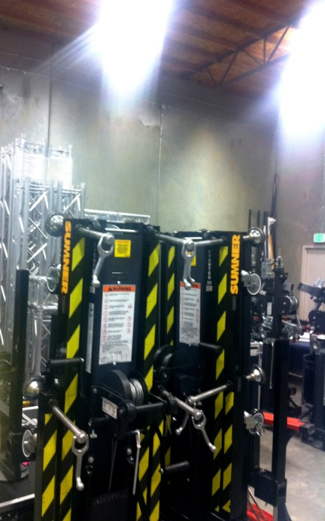
Marketing Plan
Physical Placement
7800 Meany Avenue, Bakersfield, CA.
Additional Warehouse.

Slide 6
Marketing Plan
Market Placement
Freestyle and Jesus Shack are real world competition.
Impulse Entertainment a virtual company placed in the “Real World” production market.

Slide 7
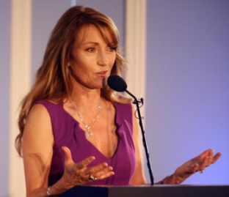
Marketing Plan
Promotion:
Direct Marketing
Bakersfield Business Conference
Constant Contact Email
Facebook and Twitter
Chamber of Commerce
Online Website

Slide 8
Balance Sheet
Half of our Virtual Enterprise loan paid
Additional box trucks for more events
Trucks fitted with natural gas engines in partnership with virtual company Natural Gas Conversion

Slide 9
Income Statement
Goal for the Year:
$2 million in sales
Gross Profit Margin
52% 2010-2011

Slide 10
Actual and Three Year Projection
Actual

Slide 11
Cash Flow
Current Outstanding cash balance of $619,342.00
Cyclical income:
Fall and Spring are our busy months

